Slide 1
Introduction to Minerals

Slide 2
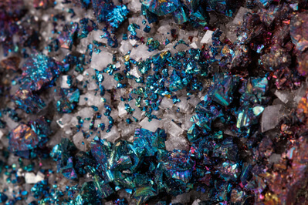

By the end of this Smart Lesson, you will be able to:
Define a mineral.
Recall the criteria used to determine a mineral.
Identify mineral examples by applying the mineral criteria.

Slide 3

What is a mineral?
If you look inside a geology textbook, you might find a definition like this:
“A mineral is a naturally occurring, inorganic substance present in the solid state, made of a specific chemical formula in a definite crystal structure.”
But if you’re like me, that sounds like gobbledygook! To begin with, let’s call a mineral the building block of a rock.
Almost all rocks are made from minerals! In this way, they’re very much like the atoms that make up the things in the world around us.

Slide 4
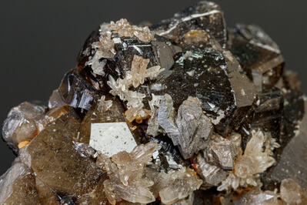
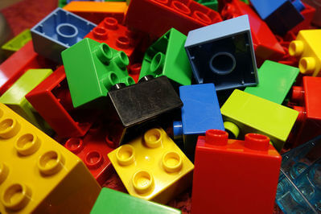
Let’s pull apart that mineral definition, starting with “naturally occurring”.
A naturally occurring object is something that is found in, well, nature. It can’t be invented in a laboratory. If all humans moved to Mars, these minerals would still exist.
In contrast, plastic and glass are synthetic materials, so these aren’t minerals.

Slide 5
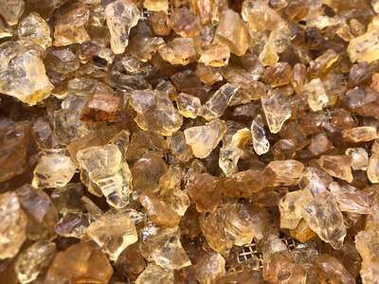

Next up: what does “inorganic” mean?
An inorganic object is not made from living material, whether plant, animal or human.
Minerals are not made from living material and are therefore inorganic. Although minerals are the building blocks of rocks, some rocks can be organic. This means the rocks are not fully made up of minerals but also contain organic material.

Slide 6

Another criteria for a mineral is that it must be found in the solid state on Earth.
Solids have a definite shape and volume—they always take up the same amount of space. This makes them hard and incompressible.
An exceptionally weird case is ice. Because we see ice in glaciers on Earth, it too is a mineral. However, water is not a mineral, because it is in the liquid state.

Slide 7
What is meant by a “specific chemical formula”?
A mineral has a fixed composition of a particular number and type(s) of elements.
For example, quartz has the formula SiO₂​, meaning that it is made of one silicon atom and two oxygen atoms. All quartz specimens contain silicon and oxygen in the same ratio.
Pure elements, such as gold (Au), can also be classified as minerals, provided they meet the other criteria.

Slide 8
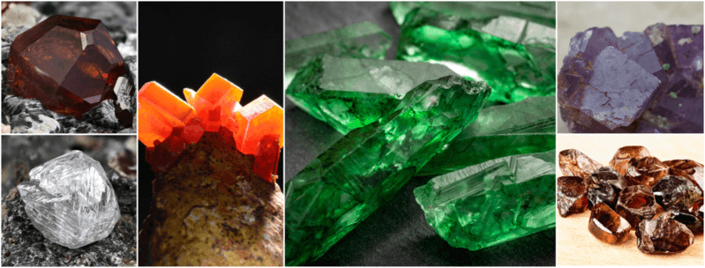
Finally, a mineral must display a crystal structure.
This means that the atoms are arranged in a highly ordered structure.
Crystal structures come in different types. For example, galena and halite form cubic crystals, but apatite forms hexagonal crystals (think of a pencil shaft).

Slide 9

How do specimens with the same composition look so different?
This ‘geo-diversity’ happens because the same mineral can appear in different crystal structures.
For example, two recognisable forms of the element carbon are the graphite found in the leads of pencils and the precious diamonds found in wedding rings.
In graphite, the carbon atoms are layered in sheets that slip and slide over each other, but in diamond, each atom is sturdily connected to four others in a cubic formation.

Slide 10
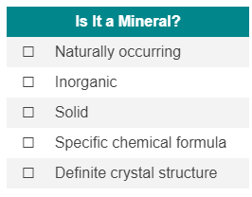
Let’s go back to our mineral definition, now that we’ve got everything sorted.
“A mineral is a naturally occurring, inorganic substance present in the solid state, made of a specific chemical formula in a definite crystal structure.”
We can enter all of that into a checklist. If the substance under study meets all of these criteria, it’s a mineral.

